Slide 1

CAPSTONE PROJECT PRESENTATION
PROJECT TITLE: XYZ COMPANY; SALES REPORT
BY:FLORENCE BABALOLA

Slide 2
HISTORICAL DATA ANALYTICS REPORT
PROBLEMS & PROJECT INSIGHTS TO BE GENERATED:
Consolidate the two-year dataset into PowerBI using PowerBI Desktop (Query Language M)Develop a Dashboard with the key metrics that you believe will provide visibility and value to the client with following key requirements:
The dashboard should allow business users to select Month and Year, and show the following metrics:
YTD Quantity Sold and QTD Quantity Sold, based on selected Month and Year. (Cards - Visual). You can assume that the transactions occurred on the first of the month.
The default values should be in shown in Unit1. Once the business user selects Unit2 , all measures (such as quantity) should recalculated to unit2.
Assume Total Cost = COGS + Distribution Cost. Calculate Margin (Sales – Total cost) by Location and other dimensions.
Insert the Above Charts into a Power Point Presentation

Slide 3
INSIGHTS GENERATED
Imported the 2 tables 2018 & 2019 (raw data) respectively.
Appended the two tables & changed data types.
Using DAX functions, performed the following calculations ;
Total Sales for 2018 & 2019
Sum of quantity sold for unit 1
Sum of quantity sold for unit 2
Total distribution cost 2018 & 2019
Count of province
Total COGS 2018 & 2019
Total Cost = Total COGS 2018 & 2019 + Total distribution 2018 & 2019
Total Margin = Total Cost - Total Sales 2018 & 2019
Introduced slicers to select year, month, and quarters towards getting breakdown for each years respectively.

Slide 4
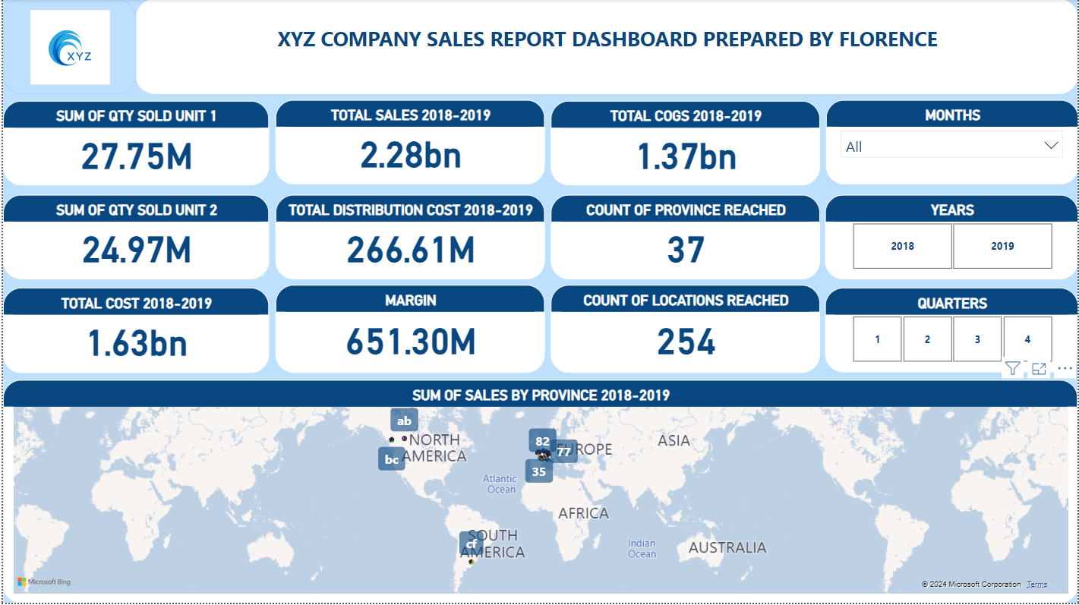
DASHBOARD REPRESENTATION OF INSIGHT GENERATED FROM THE DATA SET

Slide 5
Key Insights
At 1,455,294,351.08, 5f as a province had the highest Sum of Sales (USD) and was 359,571.06% higher than 82, which had the lowest Sum of Sales (USD)
The following insights below were also generated for the 2 years respectively;

Slide 6
KPIs | 2018 | 2019
TOTAL SALES | 1.20bn | 1.08bn
TOTAL MARGIN | 336.53M | 314.77M
TOTAL DISTRIBUTION COST | 147.18M | 119.43M
TOTAL COST | 865.93M | 766.01M
TOTAL COGS | 718.75M | 646.58M
TOTAL QTY SOLD UNIT 1 | 14.64M | 13.11M
TOTAL QTY SOLD UNIT 2 | 13.18M | 11.80M

